Slide 1
CPU Scheduling

Slide 2
Introduction
CPU scheduling in an operating system is the process of selecting which ready process should execute next on the CPU to ensure efficient utilization of the CPU and to improve system performance.
It manages the allocation of the CPU among competing processes, deciding when, and for how long, each process gets to run.
The primary goals of CPU scheduling are to maximize CPU utilization, minimize waiting and turnaround times for processes, and provide a responsive and fair system for all users and tasks.

Slide 3
Why is CPU Scheduling Necessary?
In a multiprogrammed system, many processes are present in memory and are ready to execute. However, a CPU can only execute one process at a time. CPU scheduling is essential to:
Maximize CPU Utilization:
It keeps the CPU busy by assigning it to a process whenever a previous process finishes or goes into a waiting state (e.g., for I/O operations), preventing it from sitting idle.
Improve System Efficiency:
By keeping the CPU busy, the overall time wasted is minimized, leading to higher productivity.
Enhance User Experience:
Scheduling algorithms aim to provide quick response times for interactive processes and complete background tasks efficiently.

Slide 4
Key Concepts
Ready Queue:
A queue of processes that are in the memory and are ready to be executed by the CPU.
Short-Term Scheduler (CPU Scheduler):
The component of the operating system that makes the final decision of which process to execute next from the ready queue.
Types of Scheduling:
Non-Preemptive Scheduling: Once a process starts executing, it continues until it completes or voluntarily releases the CPU.
Preemptive Scheduling: The operating system can interrupt a running process and allocate the CPU to another process, usually based on priority or time slicing.

Slide 5
CPU Scheduling Criteria
CPU Utilization:
Aims to keep the CPU as busy as possible to avoid wasting cycles, ideally operating at 100%.
Throughput:
Measures the total number of processes that are completed per unit of time; higher throughput indicates a more efficient system.
Turnaround Time:
The total time taken for a process to execute, from its submission to its completion.
Waiting Time:
The sum of the time a process spends waiting in the ready queue to acquire the CPU.
Response Time:
The time from when a request is submitted to the system until the first response is produced, crucial for interactive systems.
Fairness:
While not a distinct metric in the same way, fairness ensures that each process receives a fair share of the CPU time over a given period, preventing any single process from monopolizing the CPU.

Slide 6
Scheduling Criteria
CPU utilization – keep the CPU as busy as possible
Throughput – # of processes that complete their execution per time unit
Turnaround time – amount of time to execute a particular process
Waiting time – amount of time a process has been waiting in the ready queue
Response time – amount of time it takes from when a request was submitted until the first response is produced, not output (for time-sharing environment)

Slide 7
Scheduling Algorithm Optimization Criteria
Max CPU utilization
Max throughput
Min turnaround time
Min waiting time
Min response time

Slide 8
Arrival time (AT) − Arrival time is the time at which the process arrives in ready queue.
Burst time (BT) or CPU time of the process − Burst time is the unit of time in which a particular process completes its execution.
Completion time (CT) − Completion time is the time at which the process has been terminated.
Turn-around time (TAT) − The total time from arrival time to completion time is known as turn-around time. TAT can be written as,
Turn-around time (TAT) = Completion time (CT) – Arrival time (AT)
Or
TAT = Burst time (BT) + Waiting time (WT)
Waiting time (WT) − Waiting time is the time at which the process waits for its allocation while the previous process is in the CPU for execution. WT is written as,
Waiting time (WT) = Turn-around time (TAT) – Burst time (BT)

Slide 9
Response time (RT) − Response time is the time at which CPU has been allocated to a particular process first time. In case of non-preemptive scheduling, generally Waiting time and Response time is same.
Gantt chart − Gantt chart is a visualization which helps to scheduling and managing particular tasks in a project. It is used while solving scheduling problems, for a concept of how the processes are being allocated in different algorithms.

Slide 10
CPU Scheduling Algorithms
First-Come, First-Served (FCFS)
Shortest Job First (SJF)
Shortest Remaining Time First (SRTF)
Round Robin (RR)
Priority Scheduling
Multilevel Queue Scheduling
Multilevel Feedback Queue Scheduling

Slide 11
First Come First Serve(FCFS)
In FCFS Scheduling,
The process which arrives first in the ready queue is firstly assigned the CPU.
In case of a tie, process with smaller process id is executed first.
It is always non-preemptive in nature.
Jobs are always executed on a first-come, first-serve basis.
It is easy to implement and use.
This method is poor in performance, and the general wait time is quite high.

Slide 12
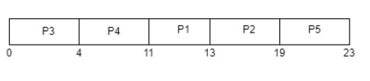
Problem 1
Consider the given table below and find Completion time (CT), Turn-around time (TAT), Waiting time (WT), Response time (RT), Average Turn-around time and Average Waiting time.
Process ID | Arrival time | Burst time
P1 | 2 | 2
P2 | 5 | 6
P3 | 0 | 4
P4 | 0 | 7
P5 | 7 | 4
Solution
Gantt chart

Slide 13
Process ID | Arrival time | Burst time | CT | TAT=CT-AT | WT=TAT-BT
P1 | 2 | 2 | 13 | 13-2= 11 | 11-2= 9
P2 | 5 | 6 | 19 | 19-5= 14 | 14-6= 8
P3 | 0 | 4 | 4 | 4-0= 4 | 4-4= 0
P4 | 0 | 7 | 11 | 11-0= 11 | 11-7= 4
P5 | 7 | 4 | 23 | 23-7= 16 | 16-4= 12

Slide 14
Examples
Process ID Arrival Time Burst Time
P 1 0 6
P 2 2 2
P 3 3 1
P 4 4 9
P 5 5 8
Process ID | Arrival Time | Burst Time | Completion Time | Turn Around Time | Waiting Time
P 1 | 0 | 6 | 6 | 6 | 0
P 2 | 2 | 2 | 8 | 6 | 4
P 3 | 3 | 1 | 9 | 6 | 5
P4 | 4 | 9 | 18 | 14 | 5
P 5 | 5 | 8 | 26 | 21 | 13

Slide 15

Gantt Chart
Response Time (RT):
(ST – AT)
P1 -> 0-0 = 0
P2-> 6-2 = 4
P3-> 8-3 = 5
P4-> 9-4 = 5
P5-> 18-5 = 13

Slide 16
First- Come, First-Served (FCFS) Scheduling
Process Burst Time
P₁ 24
P₂ 3
P₃ 3
Suppose that the processes arrive in the order: P₁ , P₂ , P₃ The Gantt Chart for the schedule is:
Waiting time for P₁ = 0; P₂ = 24; P₃ = 27
Average waiting time: (0 + 24 + 27)/3 = 17

Slide 17
FCFS Scheduling (Cont.)
Suppose that the processes arrive in the order:
P₂ , P₃ , P₁
The Gantt chart for the schedule is:
Waiting time for P₁ = 6; P₂ = 0; P₃ = 3
Average waiting time: (6 + 0 + 3)/3 = 3
Much better than previous case
The convoy effect in the FCFS (First-Come, First-Serve) scheduling algorithm occurs when a long-duration process occupies the CPU or other system resources, causing numerous shorter processes in the queue to wait behind it for an extended time.
This phenomenon leads to decreased overall system efficiency and increased average wait times for the shorter tasks.

Slide 18
Shortest-Job-First (SJF) Scheduling
Till now, we were scheduling the processes according to their arrival time (in FCFS scheduling). However, SJF scheduling algorithm, schedules the processes according to their burst time.
In SJF scheduling, the process with the lowest burst time, among the list of available processes in the ready queue, is going to be scheduled next.
However, it is very difficult to predict the burst time needed for a process hence this algorithm is very difficult to implement in the system.
Advantages of SJF
Maximum throughput
Minimum average waiting and turnaround time
Disadvantages of SJF
May suffer with the problem of starvation
It is not implementable because the exact Burst time for a process can't be known in advance.

Slide 19
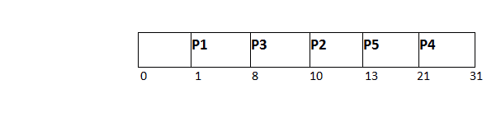
Example of SJF
There are five jobs named as P1, P2, P3, P4 and P5. Their arrival time and burst time are given in the table below.
PID | Arrival Time(AT) | Burst Time(BT) | Completion Time(CT) | Turn Around Time(TAT) | Waiting Time(WT) | Response Time(RT)
P1 | 1 | 7 | 8 | 7 | 0
P2 | 3 | 3 | 13 | 10 | 7
P3 | 6 | 2 | 10 | 4 | 2
P4 | 7 | 10 | 31 | 24 | 14
P5 | 9 | 8 | 21 | 12 | 4
Gantt chart

Slide 20
PROCESS ID | ARRIVAL TIME | BURST TIME
P0 | 5 | 8
P1 | 0 | 5
P2 | 4 | 9
P3 | 1 | 2
Solution:
Let us use the Gantt Chart for the above-given problem.
P1 P3 P0 P2
0 5 7 15 24
PROCESS ID | ARRIVAL TIME | BURST TIME | COMPLETION TIME | TURN AROUND TIME | WAITING TIME
P0 | 5 | 8 | 21 | 16 | 8
P1 | 0 | 5 | 5 | 5 | 0
P2 | 4 | 9 | 16 | 12 | 3
P3 | 1 | 2 | 7 | 6 | 4

Slide 21
Shortest-Remaining-Time-First(SRTF)
This Algorithm is the preemptive version of SJF scheduling. In SRTF, the execution of the process can be stopped after certain amount of time. At the arrival of every process, the short term scheduler schedules the process with the least remaining burst time among the list of available processes and the running process.
Now we add the concepts of varying arrival times and preemption to the analysis
ProcessA arri Arrival TimeT Burst Time
P₁ 0 8
P₂ 1 4
P₃ 2 9
P₄ 3 5
Gantt Chart
Average waiting time = [(10-1)+(1-1)+(17-2)+5-3)]/4 = 26/4 = 6.5 msec

Slide 22

Example
Process ID | Arrival Time | Burst Time | Completion Time | Turn Around Time | Waiting Time | Response Time
P1 | 0 | 8 | 20 | 20 | 12 | 0
P2 | 1 | 4 | 10 | 9 | 5 | 1
P3 | 2 | 2 | 4 | 2 | 0 | 2
P4 | 3 | 1 | 5 | 2 | 1 | 4
P5 | 4 | 3 | 13 | 9 | 6 | 10
P6 | 5 | 2 | 7 | 2 | 0 | 5

Slide 23
Priority Scheduling
A priority number (integer) is associated with each process
The CPU is allocated to the process with the highest priority (smallest integer ≡ highest priority)
Preemptive
Non-preemptive
Problem ≡ Starvation – low priority processes may never execute
In priority scheduling, starvation occurs when low-priority processes are indefinitely blocked from CPU execution due to continuous arrival of higher-priority processes.
Solution ≡ Aging – as time progresses increase the priority of the process
Aging is a technique that prevents starvation by gradually increasing the priority of processes that have waited in the ready queue for a long time, ensuring they eventually gain CPU access. For example, a background process with initially low priority might have its priority increased over time, allowing it to run after many user applications have finished.

Slide 24
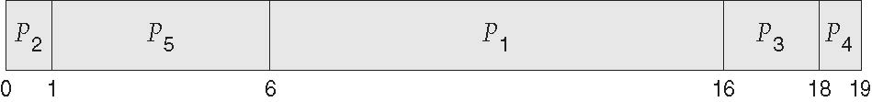
Priority Scheduling
ProcessA arri Burst TimeT Priority
P₁ 10 3
P₂ 1 1
P₃ 2 4
P₄ 1 5
P₅ 5 2
Priority scheduling Gantt Chart
Average waiting time = 8.2 msec
Non-Preemptive

Slide 25
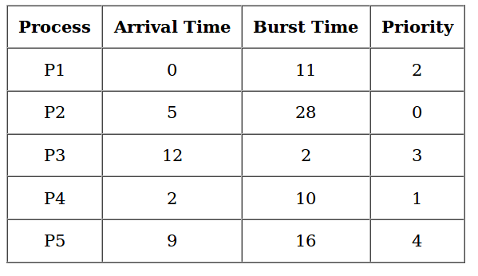
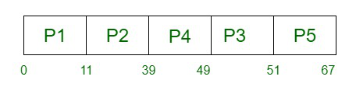

Slide 26
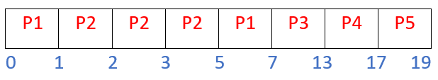
Preemptive Priority Scheduling Algorithm
Process | Arrival Time | Priority | Burst Time
P1 | 0 ms | 3 | 3 ms
P2 | 1 ms | 2 | 4 ms
P3 | 2 ms | 4 | 6 ms
P4 | 3 ms | 6 | 4 ms
P5 | 5 ms | 10 | 2 ms

Slide 27

Total Turn Around Time = 7 + 4 + 11 + 14 + 14 = 50 ms Average Turn Around Time = (Total Turn Around Time)/(no. of processes) = 50/5 = 10.00 ms
Total Waiting Time = 4 + 0 + 5 + 10 + 12 = 31 ms
Average Waiting Time = (Total Waiting Time)/(no. of processes) = 31/5 = 6.20 ms
Total Response Time = 0 + 0 + 5 + 10 + 12 = 27 ms
Average Response Time = (Total Response Time)/(no. of processes) = 27/5 = 5.40 ms

Slide 28
Process Id | Arrival time | Burst time | Priority
P1 | 0 | 4 | 2
P2 | 1 | 3 | 3
P3 | 2 | 1 | 4
P4 | 3 | 5 | 5
P5 | 4 | 2 | 5
If the CPU scheduling policy is priority preemptive, calculate the average waiting time and average turn around time. (Higher number represents higher priority)

Slide 29
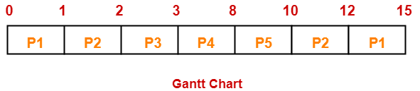
Solution-
Gantt Chart-
Id | CT | Turn Around time | Waiting time
P1 | 15 | 15 – 0 = 15 | 15 – 4 = 11
P2 | 12 | 12 – 1 = 11 | 11 – 3 = 8
P3 | 3 | 3 – 2 = 1 | 1 – 1 = 0
P4 | 8 | 8 – 3 = 5 | 5 – 5 = 0
P5 | 10 | 10 – 4 = 6 | 6 – 2 = 4
AVG(Turn Around time) = (15 + 11 + 1 + 5 + 6) / 5 = 38 / 5 = 7.6 unit
AVG(waiting time) = (11 + 8 + 0 + 0 + 4) / 5 = 23 / 5 = 4.6 unit

Slide 30
Q. Consider the following set of processes with their CPU burst time, arrival time given in milliseconds and priority. Draw GANTT charts for each execution using SRTF, RR(quantum=2) and preemptive priority scheduling. Compute average response time, average waiting time and average turnaround time for each of the algorithms.
Process | CPU burst time | Arrival time | Priority
P1 | 3 | 0 | 1
P2 | 2 | 1 | 0
P3 | 4 | 3 | 2
P4 | 5 | 4 | 0
P5 | 3 | 5 | 1

Slide 31
Round Robin (RR)
Round Robin is a CPU scheduling algorithm where each process is cyclically assigned a fixed time slot.
Round Robin CPU Algorithm generally focuses on Time Sharing technique.
The period of time for which a process or job is allowed to run in a pre-emptive method is called time quantum.
Each process or job present in the ready queue is assigned the CPU for that time quantum, if the execution of the process is completed during that time then the process will terminate else the process will go back to the Ready Queue and wait for its next turn to complete the execution.

Slide 32
Advantages of Round Robin CPU Scheduling Algorithm
There is fairness since every process gets an equal share of the CPU.
The newly created process is added to the end of the ready queue.
A round-robin scheduler generally employs time-sharing, giving each job a time slot or quantum.
While performing a round-robin scheduling, a particular time quantum is allotted to different jobs.
Each process get a chance to reschedule after a particular quantum time in this scheduling.

Slide 33

Example-1:
Consider the following table of arrival time and burst time for four processes P1, P2, P3, and P4 and given Time Quantum = 2
Process | Arrival Time | Burst Time
P1 | 0 ms | 5 ms
P2 | 1 ms | 4 ms
P3 | 2 ms | 2 ms
P4 | 4 ms | 1 ms

Slide 34
Processes | AT | BT | CT | TAT | WT
P1 | 0 | 5 | 12 | 12-0 = 12 | 12-5 = 7
P2 | 1 | 4 | 11 | 11-1 = 10 | 10-4 = 6
P3 | 2 | 2 | 6 | 6-2 = 4 | 4-2 = 2
P4 | 4 | 1 | 9 | 9-4 = 5 | 5-1 = 4
Average Turn around time = (12 + 10 + 4 + 5)/4 = 31/4 = 7.7
Average waiting time = (7 + 6 + 2 + 4)/4 = 19/4 = 4.7

Slide 35
Process Id | Arrival time | Burst time
P1 | 0 | 5
P2 | 1 | 3
P3 | 2 | 1
P4 | 3 | 2
P5 | 4 | 3
If the CPU scheduling policy is Round Robin with time quantum = 2 unit, calculate the average waiting time and average turn around time.

Slide 36
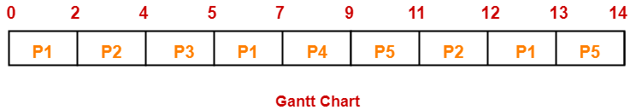

Slide 37
Let us consider a system that has four processes which have arrived at the same time in the order P1, P2, P3 and P4. The burst time in milliseconds of each process is given by the following table −
Process | CPU Burst Times in ms
P1 | 8
P2 | 10
P3 | 6
P4 | 4
GANTT Chart with time quantum of 2ms

Slide 38
Multilevel Queue (MLQ)
A method of organizing the tasks or processes that a computer must perform is multilevel queue scheduling.
The computer system divides tasks or processes into different queues based on their priority in this method.
A task’s priority can be determined by factors such as memory capacity, process priority, or type.
There are two main types of processes in the computer system:
interactive processes and background processes. Interactive processes need to be done quickly because they are being used by a person, while background processes can wait because they are not as important.

Slide 39
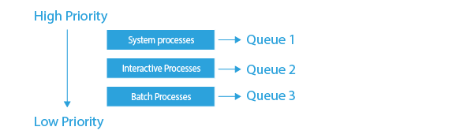
System Process The OS has its own process to run, known as the System Process.
Interactive Process The System Process, a process that the OS has to run, is known as such.
Batch Process An operating system function called batch processing gathers applications and data into a batch before processing begins.

Slide 40
Multilevel Queue (MLQ)
Key idea: divide the ready queue in two
High priority queue for interactive processes
RR scheduling
Low priority queue for CPU bound processes
FCFS scheduling
Simple, static configuration
Each process is assigned a priority on startup
Each queue is given a fixed amount of CPU time
80% to processes in the high priority queue
20% to processes in the low priority queue

Slide 41
MLQ Example
Process | Arrival Time | Priority
P1 | 0 | 1
P2 | 0 | 1
P3 | 0 | 1
P4 | 0 | 2
P5 | 1 | 2
80% High priority, RR
20% low priority, FCFS
P1
P2
P3
P1
P2
P3
P1
P2
P4
Time: 0
2
4
6
8
10
12
14
16
20
P3
P1
P2
P3
P1
P2
P3
P1
P4
Time: 20
22
24
26
28
30
32
34
36
40
P2
P3
P1
P2
P3
P1
P2
P3
P4
P5
Time: 40
42
44
46
48
50
52
54
56
60

Slide 42
Problems with MLQ
Assumes you can classify processes into high and low priority
How could you actually do this at run time?
What of a processes’ behavior changes over time?
i.e. CPU bound portion, followed by interactive portion
Highly biased use of CPU time
Potentially too much time dedicated to interactive processes
Convoy problems for low priority tasks

Slide 43
Multilevel Feedback Queue (MLFQ)
Goals
Minimize response time and turnaround time
Dynamically adjust process priorities over time
No assumptions or prior knowledge about burst times or process behavior
High level design: generalized MLQ
Several priority queues
Move processes between queue based on observed behavior (i.e. their history)

Slide 44
Multilevel Queue
Ready queue is partitioned into separate queues, eg:
foreground (interactive)
background (batch)
Process permanently in a given queue
Each queue has its own scheduling algorithm:
foreground – RR
background – FCFS
Scheduling must be done between the queues:
Fixed priority scheduling; (i.e., serve all from foreground then from background). Possibility of starvation.
Time slice – each queue gets a certain amount of CPU time which it can schedule amongst its processes; i.e., 80% to foreground in RR
20% to background in FCFS

Slide 45
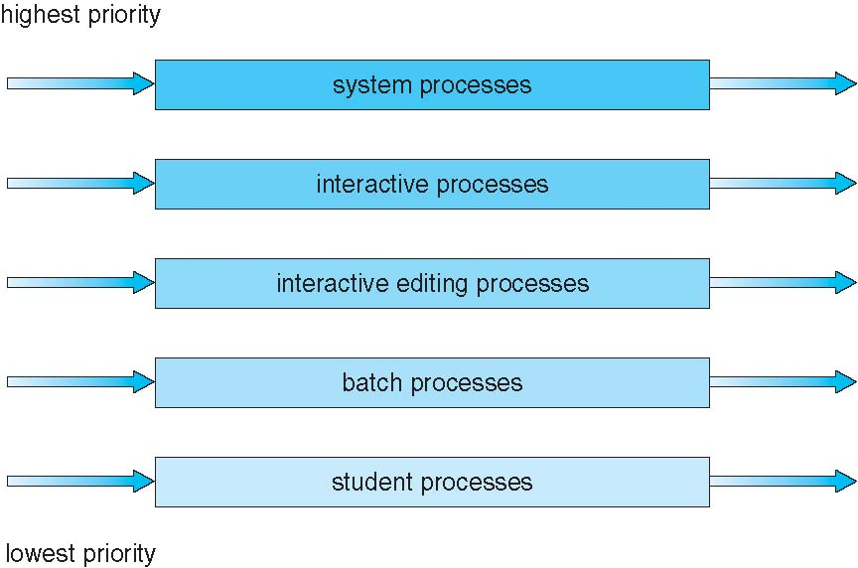
Multilevel Queue Scheduling

Slide 46
Multilevel Feedback Queue
A process can move between the various queues; aging can be implemented this way
Multilevel-feedback-queue scheduler defined by the following parameters:
number of queues
scheduling algorithms for each queue
method used to determine when to upgrade a process
method used to determine when to demote a process
method used to determine which queue a process will enter when that process needs service

Slide 47
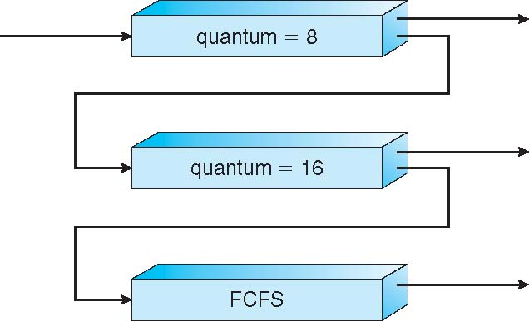
Example of Multilevel Feedback Queue
Three queues:
Q₀ – RR with time quantum 8 milliseconds
Q₁ – RR time quantum 16 milliseconds
Q₂ – FCFS
Scheduling
A new job enters queue Q₀ which is served FCFS
When it gains CPU, job receives 8 milliseconds
If it does not finish in 8 milliseconds, job is moved to queue Q₁
At Q₁ job is again served FCFS and receives 16 additional milliseconds
If it still does not complete, it is preempted and moved to queue Q₂

